Slide 1

CENG 789 – Digital Geometry Processing
03- Point Sets
Assoc. Prof. Yusuf Sahillioğlu
Computer Eng. Dept, , Turkey

Slide 2
Point Sets
<number> / 51
Focusing on point sets now.
  Convex hulls, triangulations (e.g., Delaunay), Voronoi diagrams.
Unlike polygonal vertices (prev lectures), point sets are unordered.

Slide 3
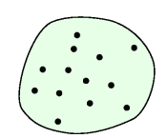
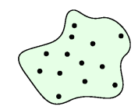
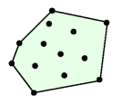
Convexity
<number> / 51
Extend convex polygon idea to convex region.
A region is convex if any 2 points a and b of the region are visible to each other, i.e., line segment ab lies within the region.
S = point set.
A nonconvex region enclosing S A convex region enclosing S
Convex hull of S

Slide 4
Convex Hull
<number> / 51
Intuition: an elastic rubber stretched around all the nails/points.
Motivation: useful for collision detection, robotics, statistics.
Formal: smallest convex region containing the point set S.
Formal: intersection of all convex regions containing S.
  Cool but impractical definition to design a construction algo.
  Practical definition based on visibility is better for algorithmic design.

Slide 5
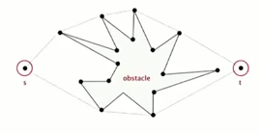
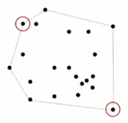
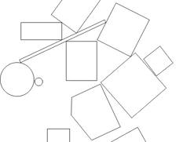
Convex Hull
<number> / 51
Motivation: useful for collision detection, robotics, statistics.
Find the shortest path from s to t that avoids the polygon obstacle.
Find a pair of points w/ the largest Euclidean distance in between.
More accurate collision detection.

Slide 6
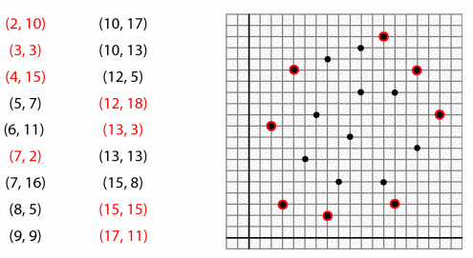
Convex Hull Construction
<number> / 51
Task: Identify hull vertices from the whole set of vertices.
Easy for your eyes if given a paper w/ marked points.
What if points are listed as coordinates (common case)?
  Take the extreme points (min/max x/y) naturally.
  What about the other hull points?
  Identifying hull vertices w/o graphing is hard.
  Even graphing/visualization fails for 1000+ points.

Slide 7
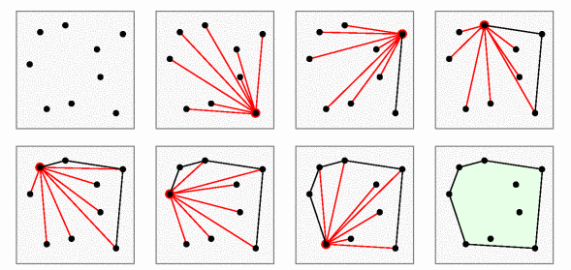
Convex Hull Construction
<number> / 51
Gift-wrapping algo to identify hull vertices in O(nh) time.
  n = # of points in point set S; h = # of hull points.
  h could be as large as n, leading to O(n^2) ☹. Such a point set? Best set?
  Extension to 3D exists.
Start w/ the bottommost pnt. Draw a line segmnt to all others. Choose the next turn-pnt on our wrapping of S to be the pnt that makes the largest angle w/ the last constructed hull edge (initially with the horizontal line).
Notes:
At each point the angle to all other points calculated, which is n. this is done as many times as there’re points on the hull: O(nh).
Angle computed by dot product. Worst case: convex position (e.g. circle), best case: set whose conv hull is a triangle; then O(n).

Slide 8
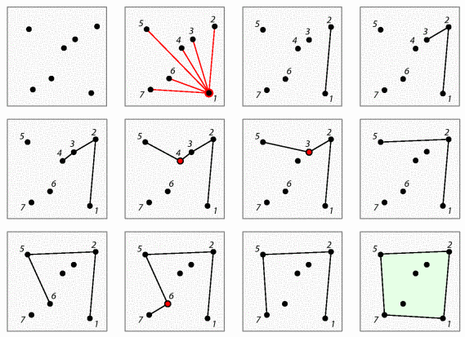
Convex Hull Construction
<number> / 51
Graham scan algo to identify hull vertices in O(nlogn) time.
  No extension to 3D.
Start w/ the bottommost pnt. Draw a line segmnt to all others. Sort the remaining points by the angles they make w/ the horizontal line. Construct the hull following this ordering (in triplets), adding pnts for left hull turns and deleting for
right turns.

Slide 9
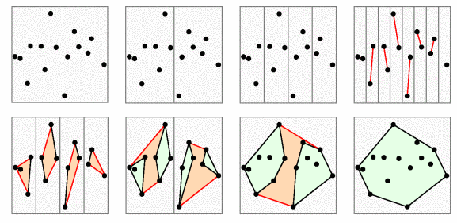
Convex Hull Construction
<number> / 51
Divide-and-conquer algo to identify hull vertices in O(nlogn) time.
  Easy extension to 3D.
Sort points by x-coordinate. Divide the points into 2 (nearly) equal groups. Compute the convex hull of each group recursively. Merge 2 groups with upper and lower supporting tangent lines.
Recurse until 3 or less points in each group, whose conv hulls trivial.

Slide 10
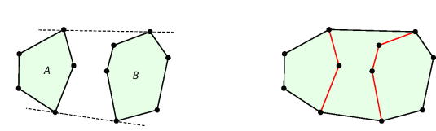
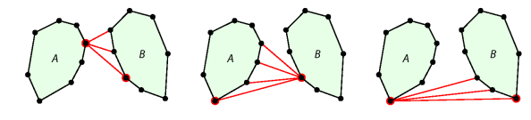
Convex Hull Construction
<number> / 51
Divide-and-conquer algo to identify hull vertices in O(nlogn) time.
  Easy extension to 3D.
Merging is tricky. Not just highest/lowest points (circle vs. tall rectangle).
O(n^2):
O(n):
Notes:
Finding the Lower Tangent
LowerTangent(HA ; HB ) :
Let a be the rightmost point of HA .
Let b be the leftmost point of HB .
While ab is not a lower tangent for HA and HB do
3a While ab is not a lower tangent to HA do a = a - 1 (move a clockwise).
3b While ab is not a lower tangent to HB do b = b + 1 (move b counterclockwise).
Return ab.

Slide 11
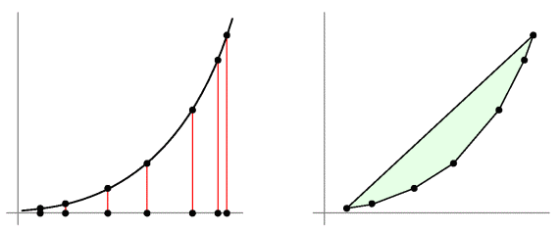
Convex Hull ~ Sorting
<number> / 51
Lower bound for any convex hull construction algo is O(nlogn) ‘cos Sorting problem reduces to Convex Hull problem: Sorting CnvxHull.
Lower bound to sort n numbers is nlogn (decision-tree model).
Given unsorted {x1, x2, .., xn}, construct the set of points in the plane (xi, xi^2) as shown:
Every point must be on the hull ‘cos parabolas are convex.
Convex hull of this parabola = identifid ordered hull vertices = sorting.
Notes:
HamCycles reduces to (or can be reduced to) TSP: HamCycle <_{p} TSP.
HamCycle is well-known to be NP-C. By reducing it to TSP, i.e., solution to TSP solves HamCycle, we prove that TSP is also NP-hard. Then show TSP is NP. So, TSP is NP-C.

Slide 12
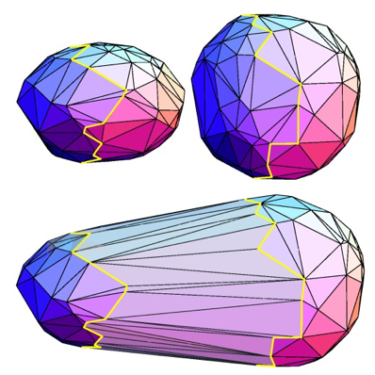
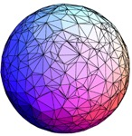
3D Convex Hull Construction
<number> / 51
Divide-and-conquer algo to identify hull vertices in O(nlogn) time.
Sort points by x-coordinate. Divide the points into 2 (nearly) equal groups. Compute the convex hull of each group recursively. Merge 2 groups with upper and lower supporting tangent planes.

Slide 13
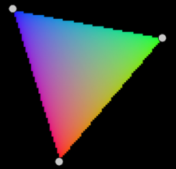
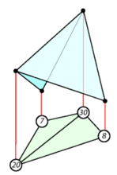
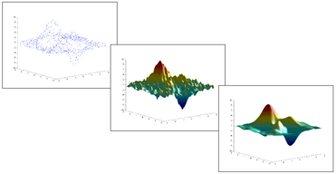
Triangulations
<number> / 51
Already did triangulation of a polygon.
Let’s do the triangulation of a structureless point set.
Convex hull is about finding the boundary of a point set.
Triangulation is about the interior of a point set.
Motivation: put a structure to scattered data so that you can make interpolations at any point in space, e.g., interpolate color or height values on scattered data points.

Slide 14
Triangulations
<number> / 51
Already did triangulation of a polygon.
Let’s do the triangulation of a structureless point set.
Convex hull is about finding the boundary of a point set.
Triangulation is about the interior of a point set.
Motivation: put a structure to scattered data so that you can make interpolations at any point in space, e.g., interpolate color or height values on scattered data points.
Interpolation schemes are discussed
in Deformation lecture slides 20-31.
Focusing on triangulations here.

Slide 15
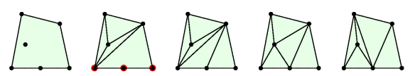
Triangulations
<number> / 51
With polygons we have boundary edges and internal diagonals.
With point sets we just have edges to describe any line segment that includes 2 points of set as endpoints.
Triangulation: of a point set S is subdivision of the plane by a maximal set of edges whose vertex set is S.
Convex hull Subdivision Triangulationsssssssssss

Slide 16

Triangulations
<number> / 51
Prove that the edges of the convex hull will be in all triangulations.
Proof: suppose not; an edge of the hull not in some triangulation. Then a point of S must be outside the convex hull, a contradiction.

Slide 17
Triangulations
<number> / 51
Prove that all region of subdivision inside conv hull must be triangles.
Proof: suppose not; some region has a region w/ 4+ edges. That region contradicts `maximal set of edges’ claim as it can be subdivided further.

Slide 18
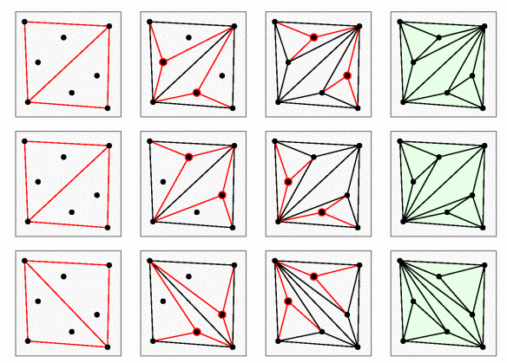
Triangulation Construction
<number> / 51
A simple algorithm called triangle-splitting to triangulate pnt set S.
Find convex hull of S and triangulate it as a polygon (previous lecture). Choose an interior point and draw edges to the 3 vertices of the triangle that contains it. Continue ‘till all interior points are done.

Slide 19
Triangulation Construction
<number> / 51
A simple algorithm called triangle-splitting to triangulate pnt set S.
Notice initial hull triangulation & processing order affect the output.

Slide 20
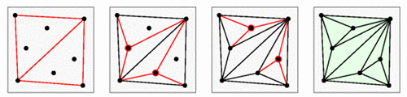
Triangulation Construction
<number> / 51
A simple algorithm called triangle-splitting to triangulate pnt set S.
Any triangulation of S using this algo has 2k+h-2 triangles, where k = # of interior points, h = # of hull points.
Proof: triangulation of the convex hull, a polygon, has h-2 triangles. An interior point replaces 1 triangle by 3, hence increasing the triangle count by 2. k interior pnts increase by 2k; hence h-2+2k.

Slide 21
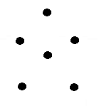
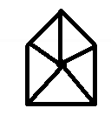

Triangulation Construction
<number> / 51
A simple algorithm called triangle-splitting to triangulate pnt set S.
Disprove that this algo produces all possible triangulations of S.
Disproof: a counterexample that can’t be produced by this algo.

Slide 22
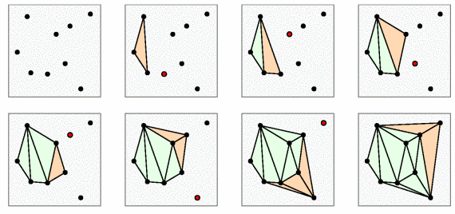
Triangulation Construction
<number> / 51
Another algorithm called incremental to triangulate pnt set S.
Sort the points of S by x-cords. First 3 points make a triangle. Consider the next point p in order and connect it w/ previously considered points which are visible to p. Continue incrementally.

Slide 23

Triangulation Construction
<number> / 51
Another algorithm called incremental to triangulate pnt set S.
Disprove that this algo produces all possible triangulations of S.
Disproof: a counterexample that can’t be produced by this algo.

Slide 24
Triangulation Construction
<number> / 51
Any triangulation of S using any algo has 2k+h-2 triangles, where k = # of interior points, h = # of hull points, n = k+h = # of points.
Proof: using Euler’s V – E + F = 2 formula. Triangulation subdivides the plane into t+1 faces, t triangles inside the hull, 1 big face outside the hull. Each triangle has 3 edges and outside face has h edges; hence 3t+h edges. Each edge touches 2 faces → 3t+h double counts edges → there’re indeed E = (3t+h)/2 edges. Apply Euler:
n – (3t+h)/2 + (t+1) = 2 → t = 2n – h – 2 → 2k + h – 2
bonus: use this t value and Euler to show # edges = 3k+2h-3
bonus: tetrahedralizations of same point set have different tets.

Slide 25
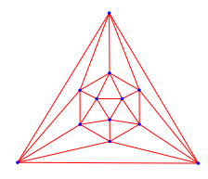
Triangulations
<number> / 51
What is interesting about this triangulation?
Notes:
All vertices degree 5.

Slide 26
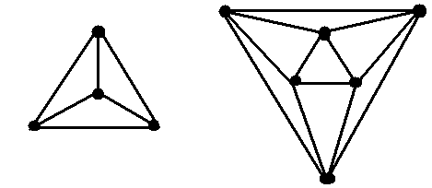

Triangulations
<number> / 51
What is interesting about these triangulations?
Notes:
All vertices degree 2, 3, and 4. k-regular.

Slide 27
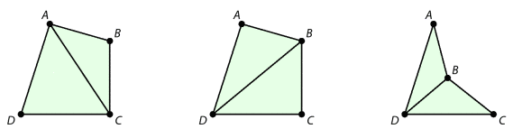
Triangulations
<number> / 51
Triangulations are related by the edge flip operation.

Slide 28
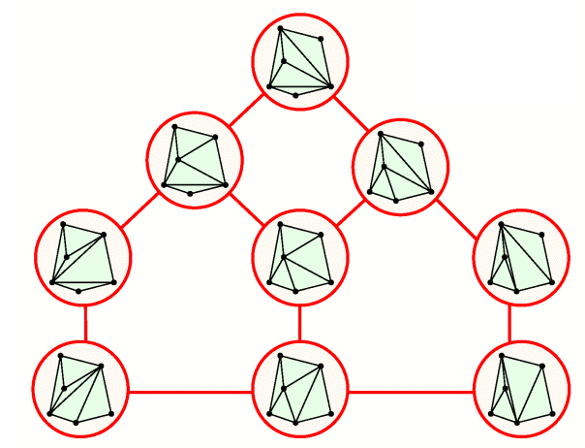
Triangulations
<number> / 51
Flip graph of a point set.
Each node is a particular triangulation of the point set.

Slide 29

Triangulations
<number> / 51
For all n construct a point set with n points whose flip graph is a single node, i.e., no flip is possible.

Slide 30
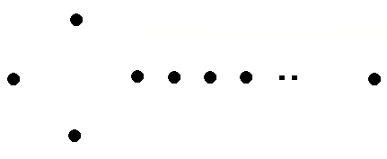
Triangulations
<number> / 51
For all n construct a point set with n points whose flip graph is 2 nodes, i.e., 2 flips are possible.

Slide 31
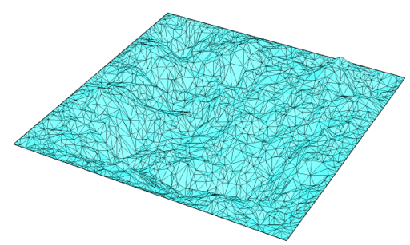
Delaunay Triangulation
<number> / 51
3d maps of earth’s surface are constructed starting from a finite sample of points whose heights (altitude) are somehow measured.
Triangulate these samples in 2D to approximate heights of nearby/unsampled points.
Then lift each samples to its correct height, providing a piecewise-linear terrain of the earth.

Slide 32
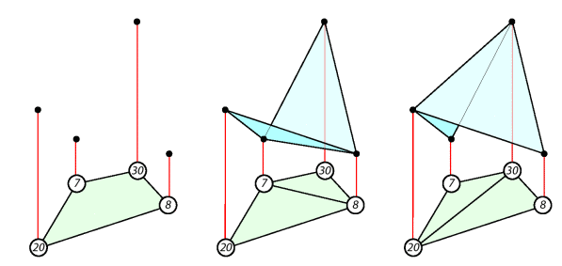
Delaunay Triangulation
<number> / 51
Which triangulation is best for this reconstruction?
deep valley steep mountain

Slide 33
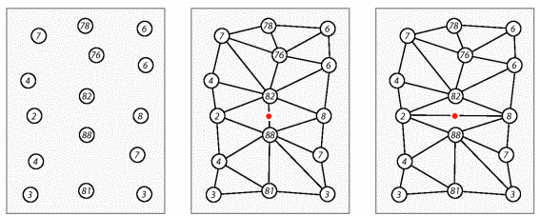
Delaunay Triangulation
<number> / 51
Our intuition renders some terrains more natural than others.
Left seems to be taken from a mountain; achieved by middle; but right part creates a deep valley that cuts the ridge in two.

Slide 34
Delaunay Triangulation
<number> / 51
Our intuition renders some terrains more natural than others.
What is cool about the middle one?
  No skinny triangles compared to the right one.
Avoid skinny triangles by picking a triangulation that maximizes the minimum angle: Delaunay Triangulation.

Slide 35
Delaunay Triangulation
<number> / 51
Angle sequence (a1, a2, .., a3n) for a triangulation w/ n triangles, sorted from smallest a1 to largest a3n.
Using the angle sequence we can compare 2 different triangulations.
Number of triangles is constant →angle sequences have same length.
T1: (20, 30, 45, 65, 70, 130)
T2: (20, 30, 45, 60, 75, 130)
  T1 > T2 (fatter) since 65 > 60.
  The fattest triangulation is the one we desire.
  Find it easily by edge flips.

Slide 36
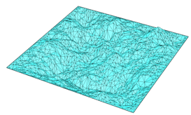
Delaunay Triangulation
<number> / 51
Let e be edge of a triangulation T1 and let Q be the quad formed by 2 triangles having e as common edge. If Q is convex, let T2 be the triangulation after flipping e in T1. We say e is legal if T1 >= T2 and illegal otherwise.
Convex hull edges of a triangulation are also legal.
Delaunay triangulation of a point set is a triangulation that only has legal edges.
Delaunay triangulation is a triangulation in which interior of any circumcircle of a triangle is empty, i.e., no points inside circumcircle.

Slide 37
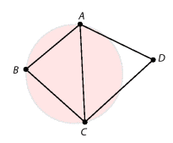
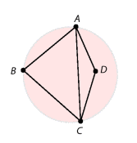
Delaunay Triangulation
<number> / 51
Put simply, a triangulation is Delaunay if no point lies within the circumcircle of any triangle.
  It also happens to maximize the minimum angle of any triangle, which is why it's useful.

Slide 38
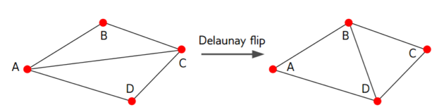
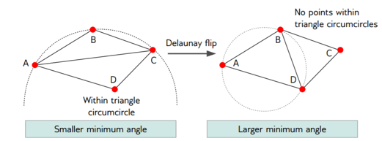
Delaunay Triangulation Construction
<number> / 51
Start with any triangulation T (e.g., slide 17 or 21). If T has an illegal edge, flip the edge and make it legal. Continue flipping illegal edges.
Put simply, flip edge if the minimum of the 6 angles increases (above).
  Guaranteed to converge (since minimum angle increases).
  Only 1 of the 2 configurations satisfies the circumcircle property.

Slide 39
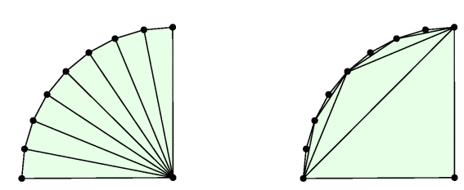
Other Special Triangulations
<number> / 51
Minimum weight triangulation (MWT).
Min ink to draw it compared to all other triangulations.
App: Minimize wiring cost of building a network.
Skinny triangles have long edges so use Delaunay to avoid them?
Not really.
Delaunay MWT

Slide 40
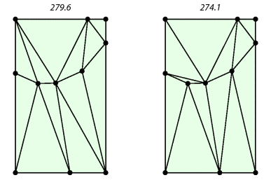
Other Special Triangulations
<number> / 51
Minimum weight triangulation (MWT).
Min ink to draw it compared to all other triangulations.
App: Minimize wiring cost of building a network.
Skinny triangles have long edges so use Delaunay to avoid them?
Not really.
Delaunay MWT

Slide 41
Other Special Triangulations
<number> / 51
Minimum weight triangulation.
Proved to be NP-hard: no polynomial-time algo known.
Alternative: instead of complete triangulation of a point set, use a tree that spans the point set; minimum spanning tree (MST).
Theorem: MST of a point set is a subset of its Delaunay triangulation.
  Justifies the intuition that Delaunay triangulation is weight-minimizing in some sense.

Slide 42
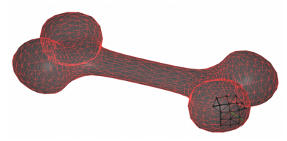

Triangulations of 3D Points
<number> / 51
Find local neighborhood L_{i} of each point p_{i} in the 3D point cloud input.
  Closest k points (using a k-d tree).
For each L_{i} compute tangent plane using PCA.
  If the input is oriented, just take the average of all normals for the plane normal.Use the mean pnt as the plane pnt (for both oriented/unoriented).
Project all points in L_{i} to the tangent plane and compute their 2D Delaunay triangulation D_{i}.
D_{i} is a set of edges: D_{i} = {e_{i}¹, e_{i}², .., e_{i}^{noe(i)} } where noe(i) where is the number of edges of the i^{th} Delaunay triangulation.
Final triangulation is the composition of all N local triangulations:
Note that global D not necessarily a 2-manifold. Set k = 0.02n and restrict value to [8,12].
See the Crust Algorithm in Surface Reconstruction slides as well (more principled).

Slide 43
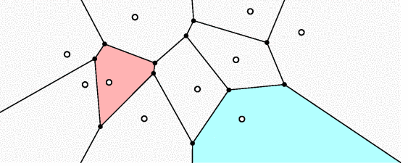
Voronoi Diagrams
<number> / 51
Convex hull ~ boundary of S.
Triangulation ~ interior of S.
Voronoi ~ points not in S.
Set of points x not in S, that are at least as close to Voronoi site p as to any other Voronoi site q in S.
Voronoi region for the site p_{k} is R_{k} = {x | ||x – p_{k}|| ≤ ||x – p_{j}||, j≠k}.
Voronoi vertices (black dots) are equidistant from 3 neighboring sites.
https://youtu.be/yDMtGT0b_kg

Slide 44
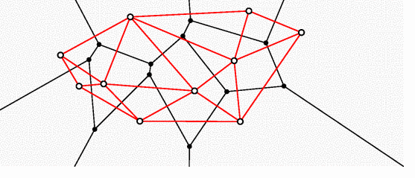
Voronoi Diagrams Application # 1
<number> / 51
Convex hull ~ boundary of S.
Triangulation ~ interior of S.
Voronoi ~ points not in S.
Dual of Delaunay triangulation: If Voronoi regions adjacent, connect their cites w/ a Delaunay edge.
https://youtu.be/PWlo7PvtQVw?t=2154

Slide 45
Voronoi Diagrams Application # 2
<number> / 51
Convex hull ~ boundary of S.
Triangulation ~ interior of S.
Voronoi ~ points not in S.
Set of points x not in S, that are at least as close to Voronoi site p as to any other Voronoi site q in S.
Nearest service handling: e.g., post office – apartment assignment. All the cyan apartments will be served from the site p’.
p’

Slide 46
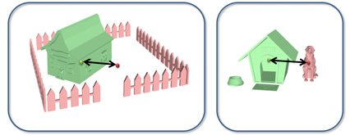
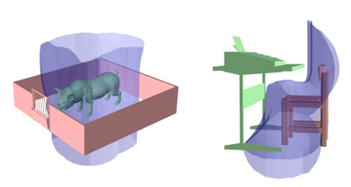
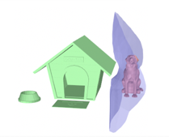
Voronoi Diagrams Application # 3
<number> / 51
Another application of Voronoi Diagrams: Interaction Representation.
  Also related to finding the separating hyperplane w/ max margin in the SVM.
Distance-based representation (not so powerful).
Interaction bisector representation (powerful).
Notes:
Indexing 3D Scenes Using the Interaction Bisector Surface, Zhao et al., 2014.

Slide 47

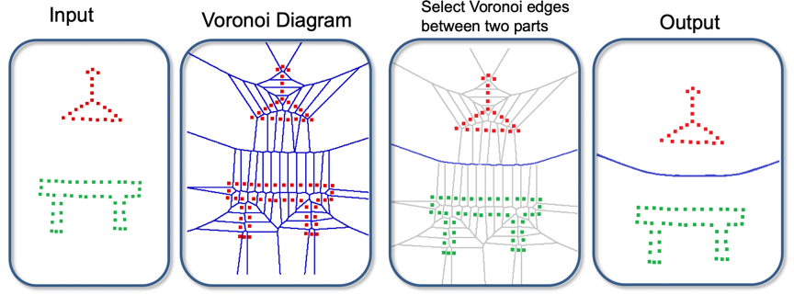
Voronoi Diagrams Application # 3
<number> / 51
Another application of Voronoi Diagrams: Interaction Representation.
  Also related to the hyperplanes in SVM.
Interaction bisector representation (powerful).

Slide 48
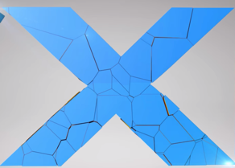
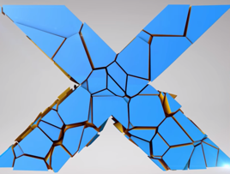
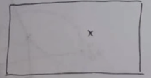
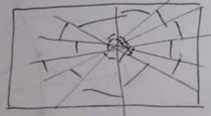

Voronoi Diagrams Application # 4
<number> / 51
Another application: Pre-fracture pattern creation for tearing/breaking.
If you know where the bullet will hit in advance, pre-fracture possible.
  Distribute dense Voronoi sites around bullet point, sparse everywhere else.
  Fracture in action: https://youtu.be/Lg2dqFCU67Q

Slide 49


Voronoi Diagrams Application # 4
<number> / 51
Another application: Pre-fracture pattern creation for tearing/breaking.
If you don’t know the contact point, rotate onthefly to match the dense Voronoi part with the collision point during simulation, e.g., for sphere.
For non-symmetric shapes, a good research problem: Real Time Dynamic Fracture with Volumetric Approximate Convex Decompositions.

Slide 50


Voronoi Diagrams Application # 5
<number> / 51
Another application: Medial axis extraction.
Medial axis is the set of interior points that have more than 1 closest boundary points.
  Superset of curve skeleton.
  Useful in many apps, e.g., deform skeleton and boundary follows (LBS).
Each Voronoi vertex has degree 3 if no 4 points are co-circular.
  Smaller circle shrinks to nothing (no site inside) and degree increases to 8.
Compute Voronoi diagram of the (boundary) points.
Voronoi vertices give you the med axis:

Slide 51

Voronoi Diagrams Application # 5
<number> / 51
Another application: Medial axis extraction.
Medial axis is the set of interior points that have more than 1 closest boundary points.
  Superset of curve skeleton.
  Useful in many apps, e.g., deform skeleton and boundary follows (LBS).
Each Voronoi vertex has degree 3 if no 4 points are co-circular.
  Smaller circle shrinks to nothing (no site inside) and degree increases to 8.
Compute Voronoi diagram of the (boundary) points.
Sensitive to noise, 1 input pnt inside
boundary dooms the medial axis:

